Slide 1
PRACTICAL EVALUATION
Shathri Gireesan

Slide 2
Question 2- Git
Solution
Commands used:
git clone https://github.com/SHATHRI/Practical.git
git checkout -b sprint1 (make changes in sprint1 branch)
git add <filename>
git commit -m "sprint1 change"
git push --set-upstream origin sprint1
git checkout master
git checkout -b sprint2 (make changes in sprint2 branch)
git commit -am "sprint2 change"
git push --set-upstream origin sprint2

Slide 3
git checkout master
git merge sprint1
git branch -D sprint2
git push
git log
git diff 4dd921 dc8240

Slide 4
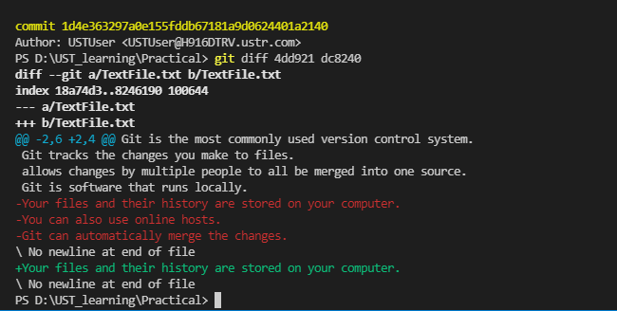
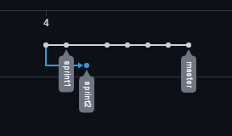

Slide 5
Question 2 - Powershell
Solution:
Commands used:
$webData = $(Invoke-RestMethod -Uri https://tools.learningcontainer.com/sample-json.json |select -ExpandProperty address)
Write-Output "This is my Address: $($webData | select -Expand streetAddress) | $($webData |select -Expand city) $($webdata | select -Expand state) $($webData |select -Expand postalCode)"

Slide 6
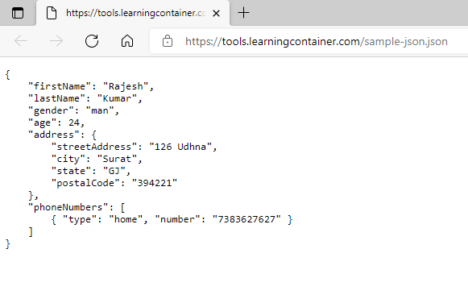

Slide 7
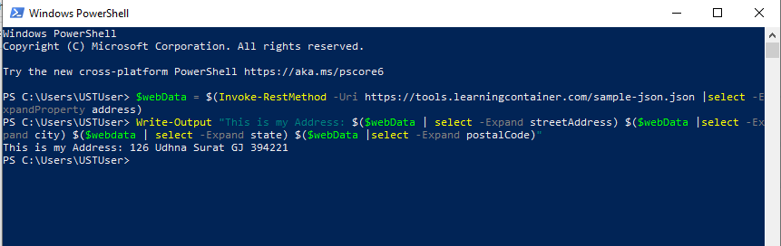

Slide 8
Question 3 - Database
Solution:
Commands used:
CREATE TABLE MANUFACTURER (
SlNo INT NOT NULL,
CompanyName VARCHAR(50) NOT NULL,
Stat VARCHAR(50) NOT NULL,
Country VARCHAR(50) NOT NULL,
manf_refs INT NOT NULL PRIMARY KEY );
select * from MANUFACTURER

Slide 9
Insert
INSERT INTO MANUFACTURER
VALUES
('1' , 'CompanyA' , 'Alabama' , 'America' , '111'),
('2' , 'CompanyB' , 'Alaska' , 'America' , '112'),
('3' , 'CompanyC' , 'Hawaii' , 'America' , '113'),
('4' , 'CompanyD' , 'Indiana' , 'America' , '114'),
('5' , 'CompanyE' , 'NewYork' , 'America' , '115');

Slide 10
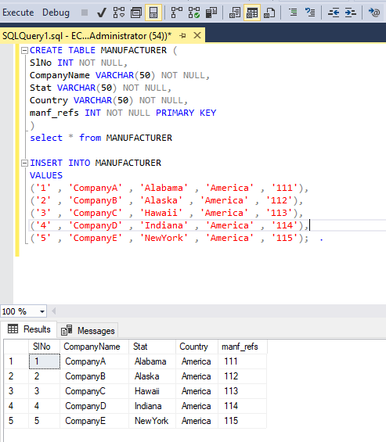

Slide 11
Table 2 Commands:
CREATE TABLE DEVICE_DETAILS (
SlNo INT NOT NULL,
ModelName VARCHAR(50) NOT NULL,
DateOfManufacure INT NOT NULL,
manf_code INT FOREIGN KEY REFERENCES MANUFACTURER(manf_refs)
);
select * from DEVICE_DETAILS

Slide 12
Insert
INSERT INTO DEVICE_DETAILS
VALUES
('1' , 'ModelA' , '2015' , '112'),
('2' , 'ModelB' , '2016' , '111'),
('3' , 'ModelC' , '2015' , '114'),
('4' , 'ModelD' , '2018' , '111'),
('5' , 'ModelE' , '2019' , '115');

Slide 13
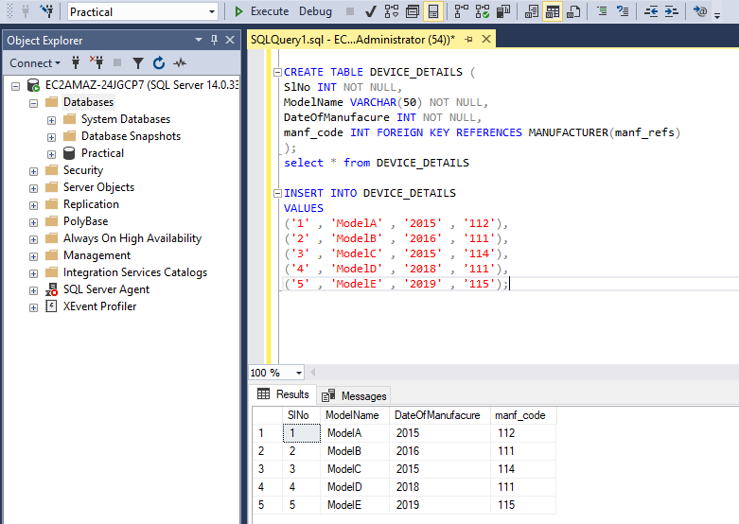

Slide 14
Update and Delete;
UPDATE MANUFACTURER SET CompanyName = 'CompanyF' , Stat = 'Missisippi' , Country = 'USA'
WHERE manf_refs = '112';
DELETE FROM MANUFACTURER WHERE SlNo = '3';

Slide 15
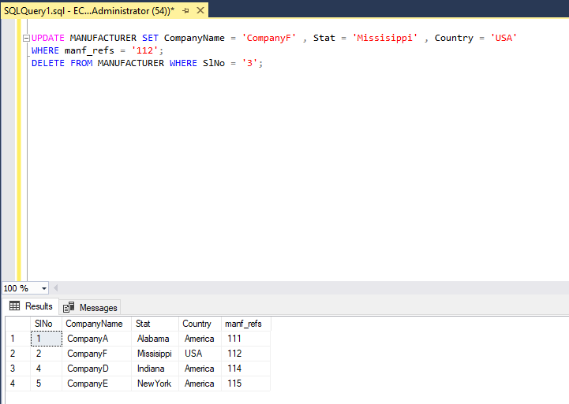

Slide 16
Join;
SELECT DEVICE_DETAILS.SlNo, DEVICE_DETAILS.ModelName, DEVICE_DETAILS.DateOfManufacure, MANUFACTURER.CompanyName
FROM MANUFACTURER
INNER JOIN DEVICE_DETAILS ON DEVICE_DETAILS.manf_code= MANUFACTURER.manf_refs
ORDER BY DEVICE_DETAILS.ModelName

Slide 17
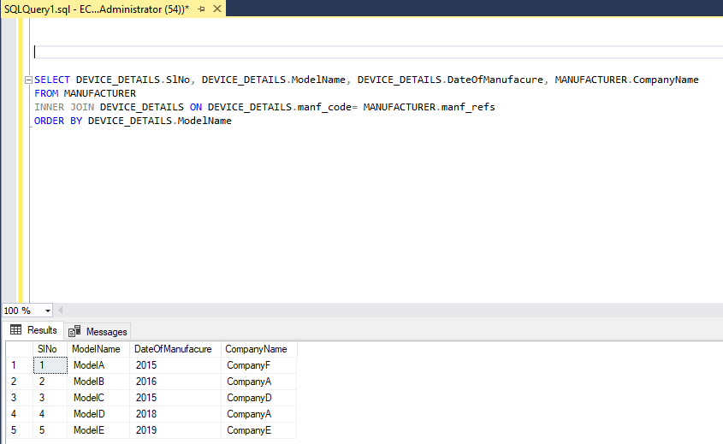

Slide 18
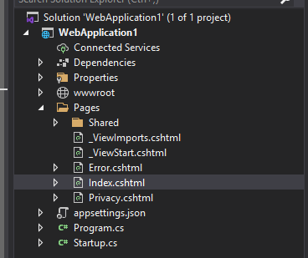
Question 4 - .Net Project
Solution:

Slide 19
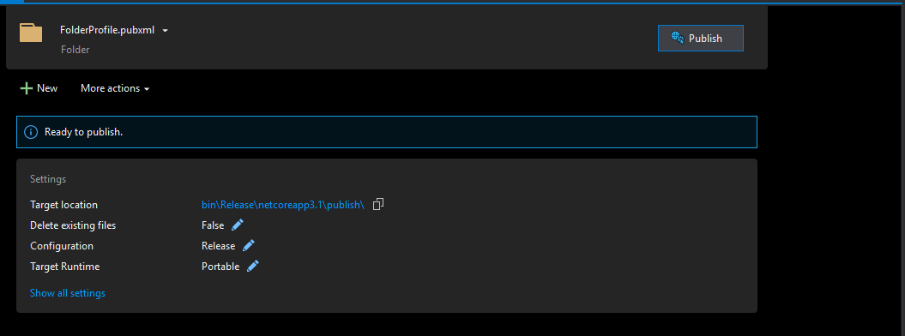

Slide 20
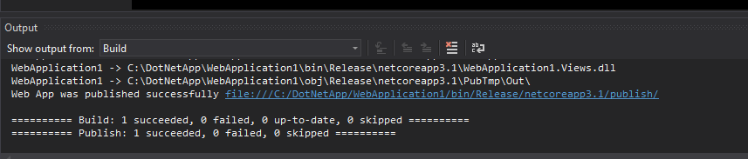

Slide 21
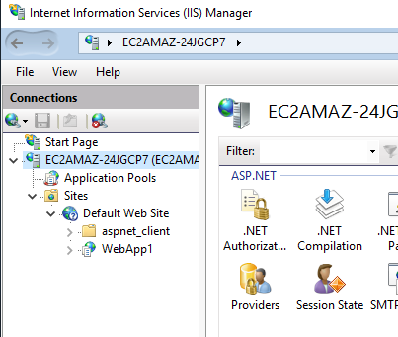

Slide 22
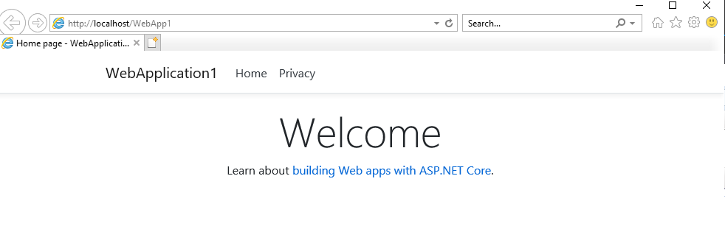

Slide 23
Thank you

